Slide 1
COVID-19 Culture Mirror
Example change templates for optional use and customization

Slide 2
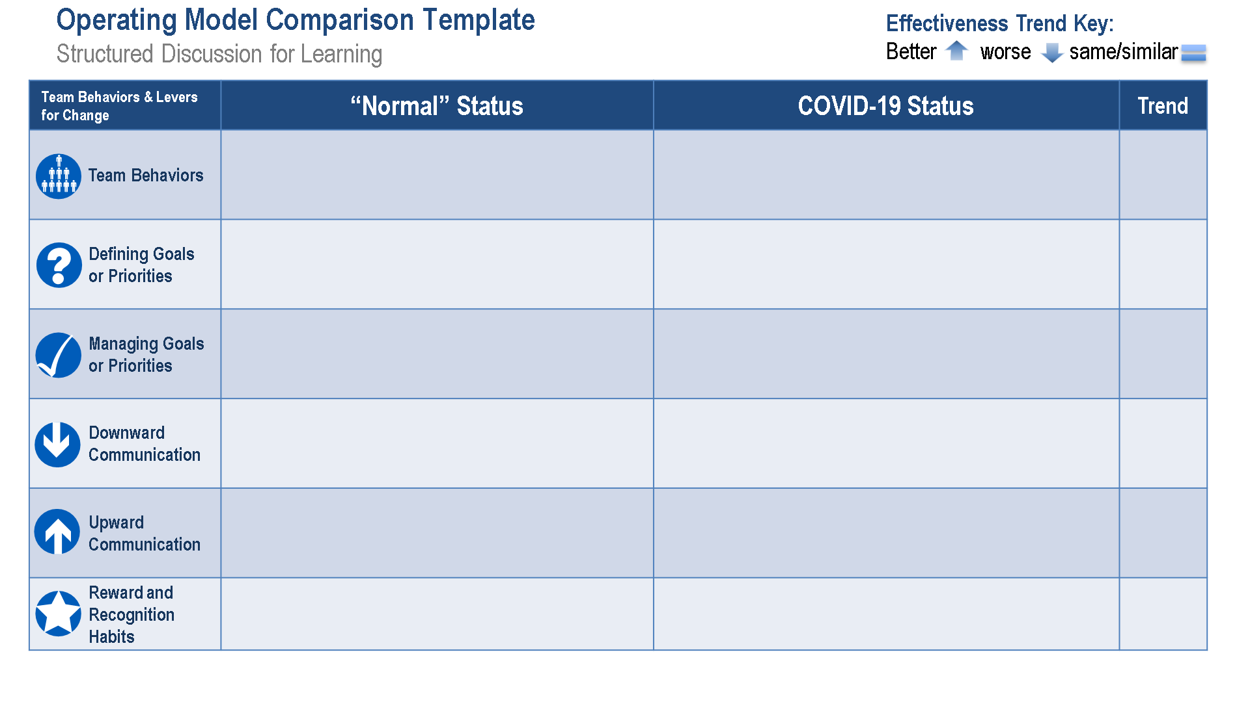
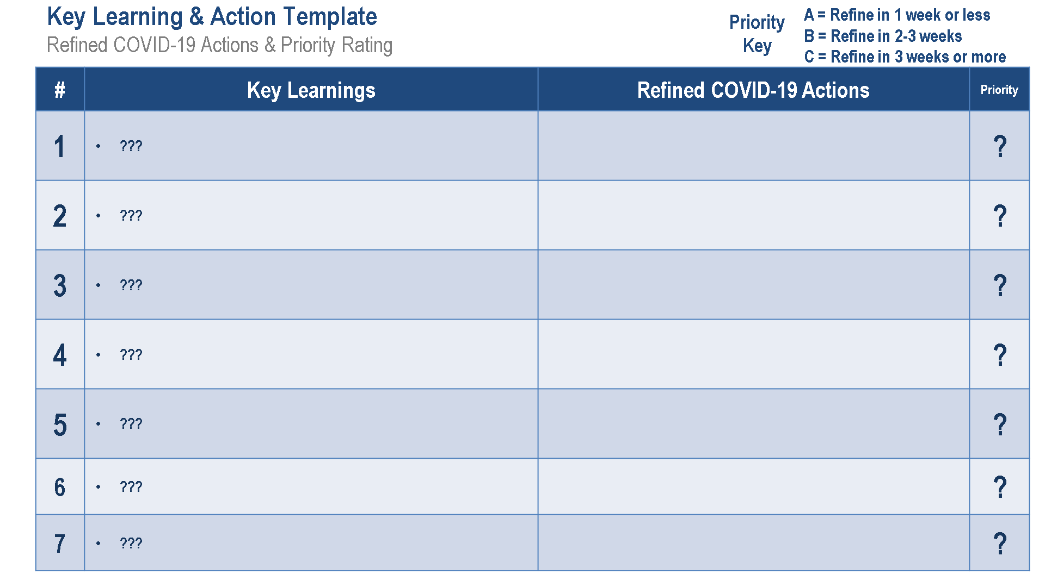
COVID-19 Culture Mirror
Example change templates for optional use and customization
Potential formats for Step 1 – What’s working, what’s not and why
What’s Working, What’s Not & Why (unstructured feedback)
Operating Model Comparison Template (structured feedback)
Operating Model Comparison Template – Tip Sheet
Start – Stop – Continue Template
What’s Working & What’s Not Template
What’s Working & Why Template
What’s Not Working & Why Template
Potential formats for Step 3 – Refine Improvement Plans
Key Learning & Action Template – COVID-19 Plans
Key Learning & Action Template – Sustainment Plans
Refined COVID-19 Operating Model

Slide 3
COVID-19 Response – What’s working, what’s not & why
Unstructured
What’s Working, What’s Not & Why
???

Slide 4
Operating Model Comparison Template
Structured Discussion for Learning
Effectiveness Trend Key:
Better worse same/similar
Team Behaviors & Levers for Change | “Normal” Status | COVID-19 Status | Trend
Team Behaviors
Defining Goals or Priorities
Managing Goals or Priorities
Downward Communication
Upward Communication
Reward and Recognition Habits

Slide 5

Team Behaviors & Levers for Change | “Normal” Status | Covid-19 Status
Team Behaviors | What passive (avoidant, dependent, conventional) or aggressive (oppositional, perfectionistic, internally competitive) behaviors exist where we are not living our values? Be specific. List 2-3 behaviors that must evolve. | For each current behavior, what must the behavior change “TO” in order to improve team effectiveness and live our values?
Defining Goals or Priorities | How do you define goals/priorities? Who do you involve in the process? | Consider obtaining prioritized feedback on original goals/priorities, refinement to drafts or other input. How will top priorities and plans be defined with greater involvement, clarity and effectiveness?
Managing Goals or Priorities | What meetings are held to review and/or track progress on goals/priorities? How often are they held? Who are involved in the reviews, how long are they and how are they documented or how are actions tracked? | Consider standard agendas, holding different types of meetings (e.g. daily, weekly, monthly, quarterly), improved documentation/tracking, etc. How can you refine preparation, participation, facilitation or follow-up?
Downward Communication | How do you communicate status on priorities and plans across your team? What different forms of communication are used (team meetings, standard emails, postings, etc.)? | Consider pre-meetings, standard agendas/formats, modified content, and revised length or content. Are additional forms of communication possible? How can you refine preparation, content or follow-up?
Upward Communication | How do you obtain team feedback on improvement ideas or changes to priorities/plans that may be needed? What meetings or other forms of standard upward feedback structures exist? | What standard forms of upward feedback systems can you implement or refine? How can you surface and eliminate drama, rumors or frustrations? How can you consistently surface ideas or improvements?
Recognition Habits | What standard recognition systems do you utilize? What unique recognition habits are also used (habits in team meetings, informal recognition, etc.)? | How can you improve use of standard recognition systems? What recognition approaches can you add to standard agendas, informal interactions, etc.?
Operating Model Comparison Template – Tip Sheet
Instructions, ideas and examples to spark discussion

Slide 6
Start – Stop – Continue Template
Structured Discussion for Learning
START | STOP | CONTINUE
??? | ??? | ???

Slide 7
What’s Working & What’s Not Template
Structured Discussion for Learning
What’s Working | What’s Not
??? | ???

Slide 8
What’s Working, What’s Not & Why (page 1)
What’s Working and Why Template
Priority
Key
A = Expand approach to other areas/priorities
B = Continue with small refinements
C = Continue
# | What’s Working | Why is it working? What does it encourage or how does it make others feel? | Priority
1 | ??? |  | ?
2 | ??? |  | ?
3 | ??? |  | ?
4 | ??? |  | ?
5 | ??? |  | ?
6 | ??? |  | ?
7 | ??? |  | ?
8 | ??? |  | ?
9 | ??? |  | ?
10 | ??? |  | ?

Slide 9
What’s Working, What’s Not & Why (page 2)
What’s Not Working and Why Template
A = Urgent change needed (now)
B = Change needed soon, timing TBD
C = Not a priority for change now
Priority
Key
# | What’s Not Working | Why isn’t it working? What doesn’t it encourage or how does it make others feel? | Priority
1 | ??? |  | ?
2 | ??? |  | ?
3 | ??? |  | ?
4 | ??? |  | ?
5 | ??? |  | ?
6 | ??? |  | ?
7 | ??? |  | ?
8 | ??? |  | ?
9 | ??? |  | ?
10 | ??? |  | ?

Slide 10
Key Learning & Action Template
Refined COVID-19 Actions & Priority Rating
A = Refine in 1 week or less
B = Refine in 2-3 weeks
C = Refine in 3 weeks or more
Priority
Key
# | Key Learnings | Refined COVID-19 Actions | Priority
1 | ??? |  | ?
2 | ??? |  | ?
3 | ??? |  | ?
4 | ??? |  | ?
5 | ??? |  | ?
6 | ??? |  | ?
7 | ??? |  | ?

Slide 11
Key Learning & Action Template
Sustainment Actions & Priority Rating
A = Start initial planning now
B = Start planning in 1-3 months
C = Start planning in 3+ months
Priority
Key
# | Key Learnings | Longer-term Sustainment Actions | Priority
1 | ??? |  | ?
2 | ??? |  | ?
3 | ??? |  | ?
4 | ??? |  | ?
5 | ??? |  | ?
6 | ??? |  | ?
7 | ??? |  | ?

Slide 12
Refined COVID-19 Operating Model Plan
Compare, Learn, Improve
Team Behaviors & Levers for Change | Before COVID-19 | Initial COVID-19 Status | Refined COVID-19 Plan
Team Behaviors
Defining Goals or Priorities
Managing Goals or Priorities
Downward Communication
Upward Communication
Reward and Recognition Habits

